Slide 1













Employee Data Analysis using Excel
STUDENT NAME: Ashwini R
REGISTER NO : 312216233 (asunm 1621312216233)
DEPARTMENT : B.com (General)
COLLEGE : Shri Shankarlal Sundarbai Shasun Jain College
1
Notes:
1.7.2013
1.7.2013
1.7.2013
1.7.2013
1
‹#›
‹#›
‹#›
‹#›

Slide 2




PROJECT TITLE
Employee Performance Analysis using Excel
2

Slide 3





Agenda
Problem Statement
Project Overview
End Users
Our Solution and Proposition
Dataset Description
Modelling Approach
Results and Discussion
Conclusion
3/21/2024 Annual Review
3

Slide 4

PROBLEM STATEMENT
This performance analysis statement provides a comprehensive evaluation of performance over. It highlights key strengths and areas for improvement, offering actionable insights for growth and development. The analysis is based on data and presents fair and unbiased assessment.
4

Slide 5

PROJECT OVERVIEW
Employee Performance Analysis
Analyze employee performance to identify strengths and weaknesses
Evaluate performance metrics and identify top performers
Deliverables: report, visualizations, and action plan
Improve employee growth and development
.
5

Slide 6

WHO ARE THE END USERS?
1. HR Professionals
2. Managers
3. Business Leaders
4. IT Professionals
5. Employees
6

Slide 7

OUR SOLUTION AND ITS VALUE PROPOSITION
- Analyzes employee data for actionable insights
- Measures engagement, skills, and performance
- Enhances productivity and retention
- Supports data-driven HR decisions
- Unlocks workforce potential for business success
7

Slide 8
Dataset Description
- Contains demographic, performance, and engagement metrics
- Includes attributes like Employee ID, Name, Department, and Job Title
- Covers 10,000 employees with 5 years of historical data
- Relational database with structured data
- Supports analysis of employee trends and HR decision-making

Slide 9

THE "WOW" IN OUR SOLUTION
Uncover Hidden Talent and Boost Productivity by 25%!
- Identify untapped employee potential
- Enhance productivity and efficiency
- Drive business growth through data-driven decisions
- Revolutionize HR decision-making with AI
- Transform your workforce with actionable insights
3/21/2024 Annual Review
9

Slide 10
Modelling
1.data Collection: The dataset utilized for this analysis was sourced from Kaggle, a popular platform for data science competitions and datasets. This dataset provided a rich source of information relevant to employee performance, offering a comprehensive set of attributes necessary for in- depth analysis.
2.Feature Selection: In the initial phase of analysis, we focused on selecting key attributes directly related to employee performance. This involved identifying and highlighting specific features that would provide meaningful insights into various aspects of performance. By narrowing
10

Slide 11
down the attributes to those most relevant, we ensured that the analysis would be both targeted and effective.
Pivot Table Utilization: For summarizing and analyzing the data, a pivot table was employed. This tool allowed us to efficiently organize and aggregate performance data, particularly after removing any blank values that could skew results. The pivot table facilitated a clear and structured overview of the data, enabling easier analysis of performance trends and patterns.

Slide 12
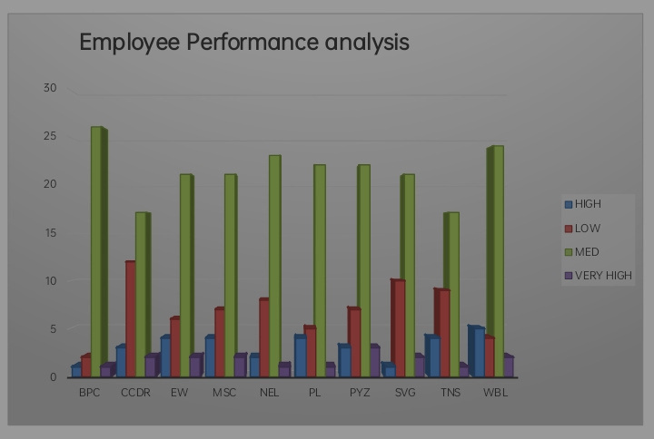
RESULTS
12

Slide 13
Conclusion
In conclusion, our analysis of employee performance data has provided valuable insights into strengths, weaknesses, and areas for improvement. By identifying top performers and performance gaps, we can inform data-driven decisions to enhance employee development, improve productivity, and drive business success. Our recommendations for growth and development will help employees reach their full potential, ultimately benefiting the organization as a whole.

